Slide 1
Photocurable Nanocomposites for
Customizable Cartilage Replacements
Presenter: Alexis Hocken
PI: Prof Matthew D. Green
School for Engineering of Matter, Transport and Energy
Arizona State University

Slide 2
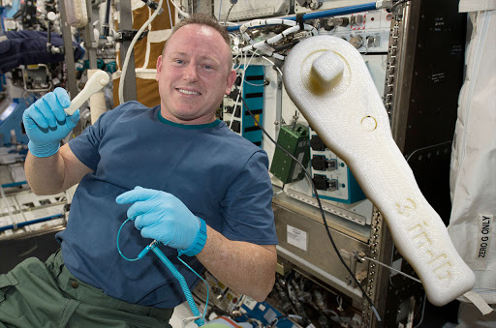
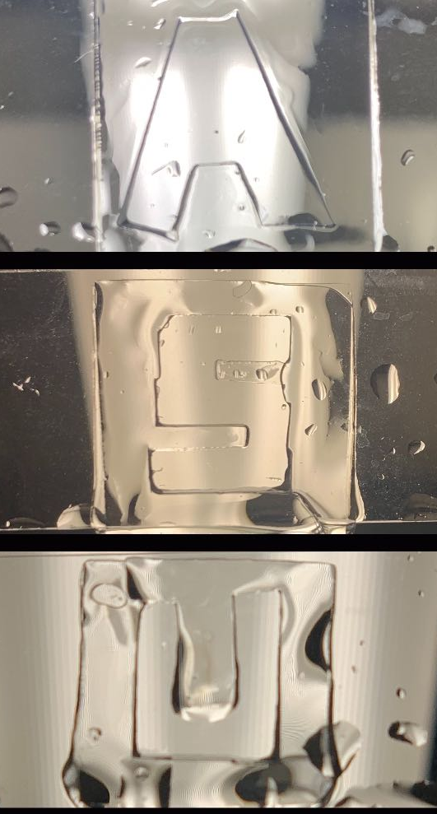

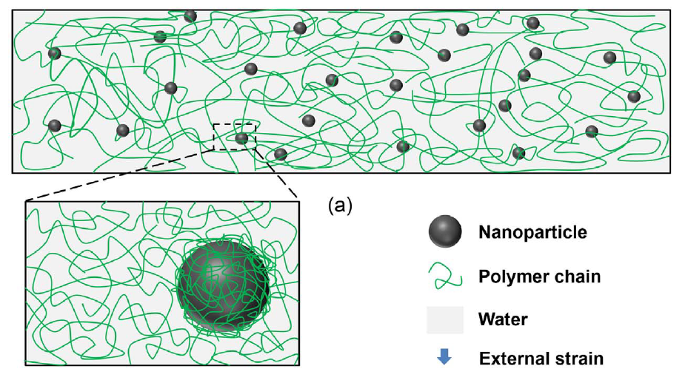
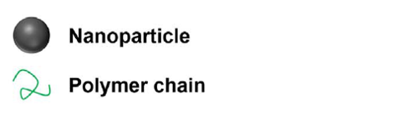
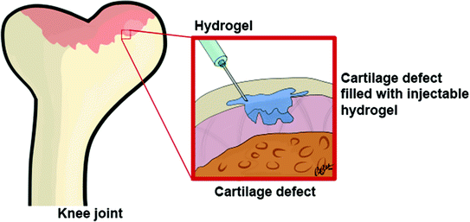
Introduction
1
Nanocomposite applications
  Consumer products
  Construction
  Biomedical applications
Zhan, et al. J. Mech. Behav. Biomed. 2017, 75, 236–243.

Slide 3
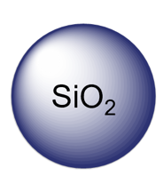
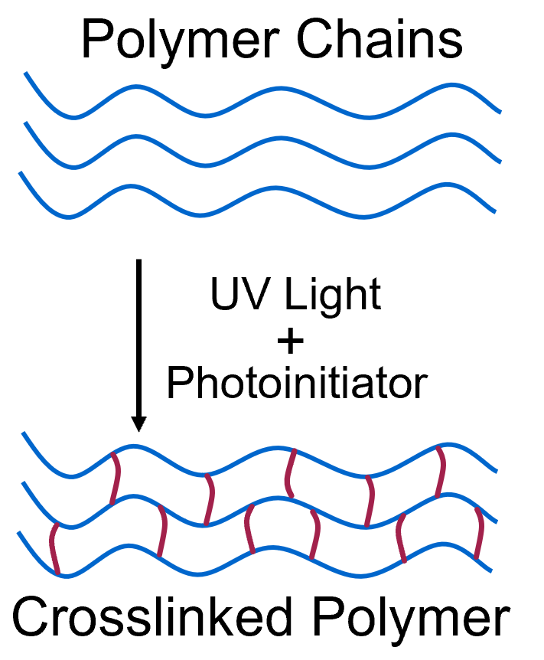
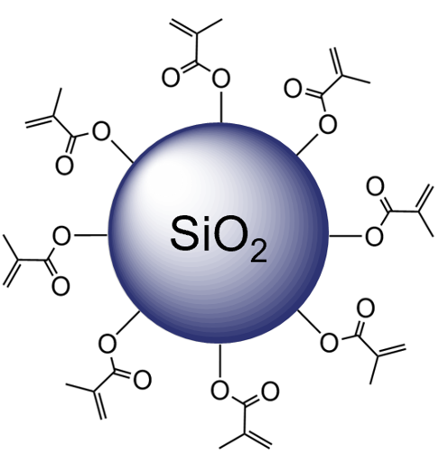
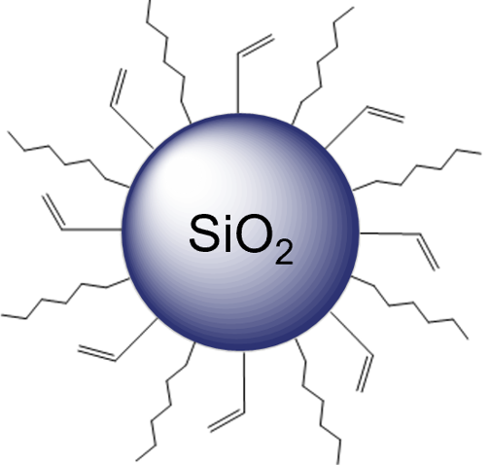
Introduction
2
This study aims to understand the influence of V-SiO₂ and MA-SiO₂ loading on the polymerization yield, morphology, and mechanical performance
We analyzed samples with 0, 3.8, 7.4, 10.7, and 13.8 wt% silica nanoparticles
Phase 1:
Photocuring Mechanism
Unfunctionalized SiO₂
Phase 2:
MA-SiO₂
V-SiO₂
Hocken, et al. Industrial & Engineering Chemistry Research. 2019, 58 (32).

Slide 4
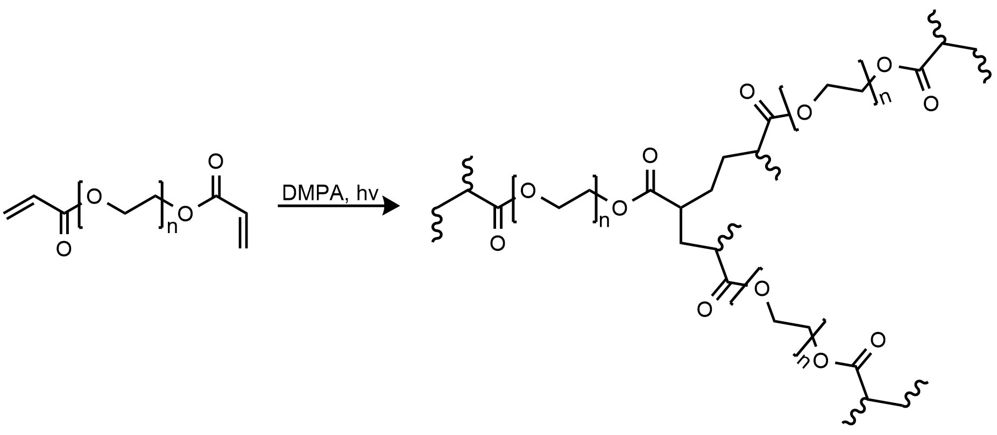
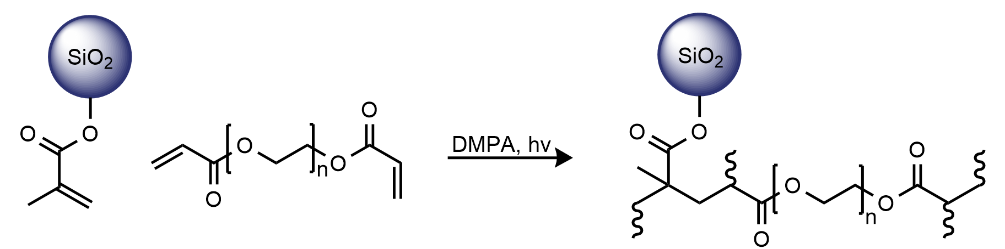
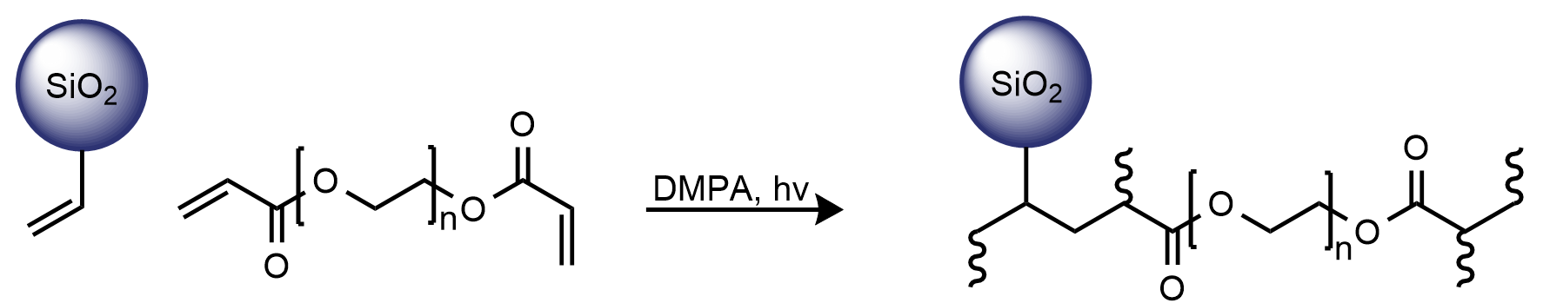
Background
3
Cross-Linking Reaction of PEGDA Initiated by DMPA under UV Light
Cross-Linking Reaction of PEGDA with MA-SiO₂
Cross-Linking Reaction of PEGDA with V-SiO₂
Hocken, et al. Industrial & Engineering Chemistry Research. 2019, 58 (32).

Slide 5
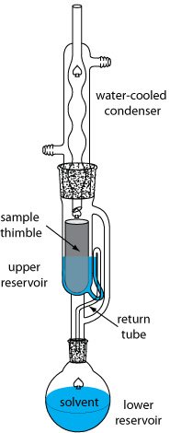
Confirming Gel Fraction
4
SiO₂*
MA-SiO₂
V-SiO₂
MA-SiO₂
V-SiO₂
*Hocken, et al. Industrial & Engineering Chemistry Research. 2019, 58 (32).
Notes:
by scavenging radicals, limiting diffusion, or simply by diluting the concentration of monomer in the system

Slide 6
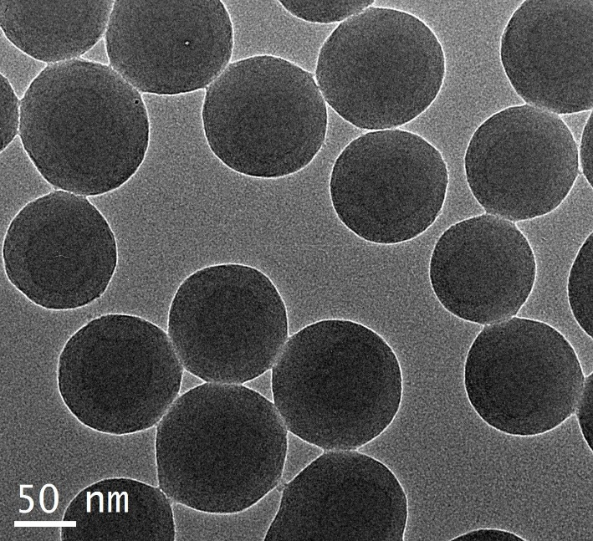
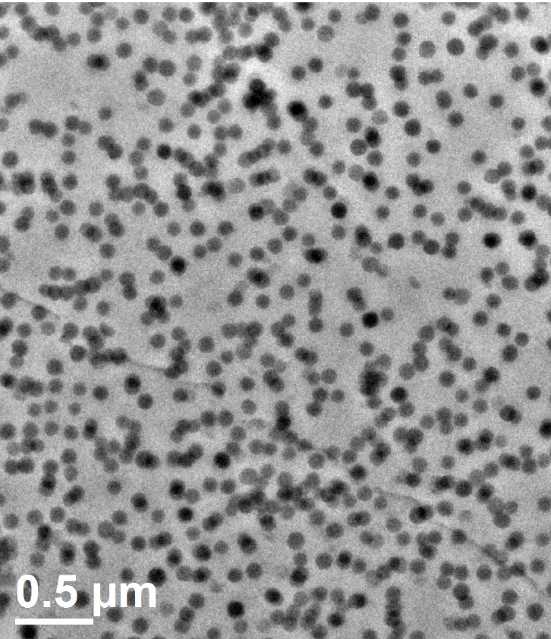
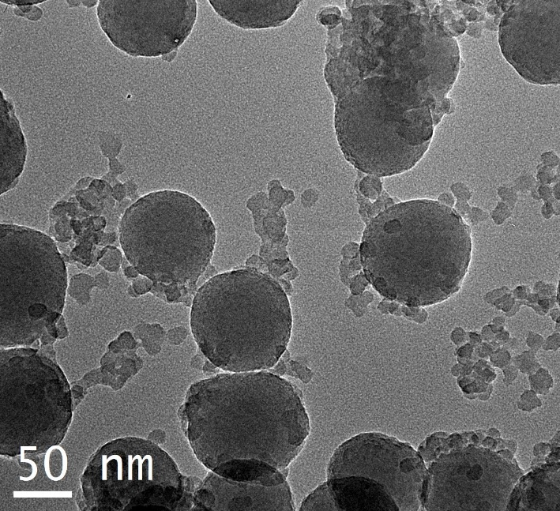
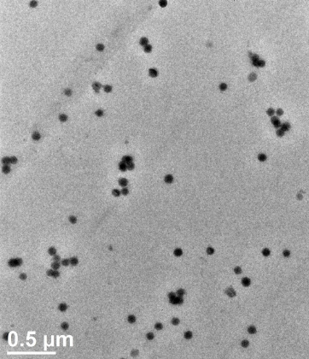
Nanoparticle Size & Dispersion
5
MA-SiO₂
NPs dispersed in methanol
Cross sectional area
MA-SiO₂: uniform size distribution and better dispersion
MA-SiO₂
MA-SiO₂
V-SiO₂
V-SiO₂: bimodal size distribution and more aggregation
V-SiO₂
V-SiO₂
Notes:
by scavenging radicals, limiting diffusion, or simply by diluting the concentration of monomer in the system

Slide 7
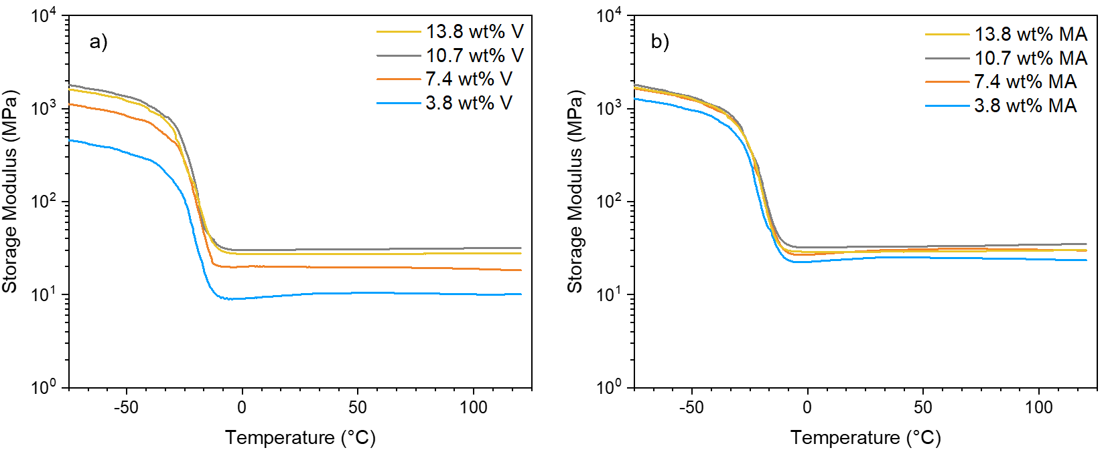
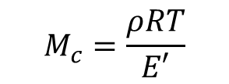
Dynamic Mechanical Behavior
6
$$M_{c}=\frac{ρRT}{E′}$$
E’ generally increases with higher loadings of NPs. MA-SiO₂ composites have a tighter network due to shorter Mc.

Slide 8
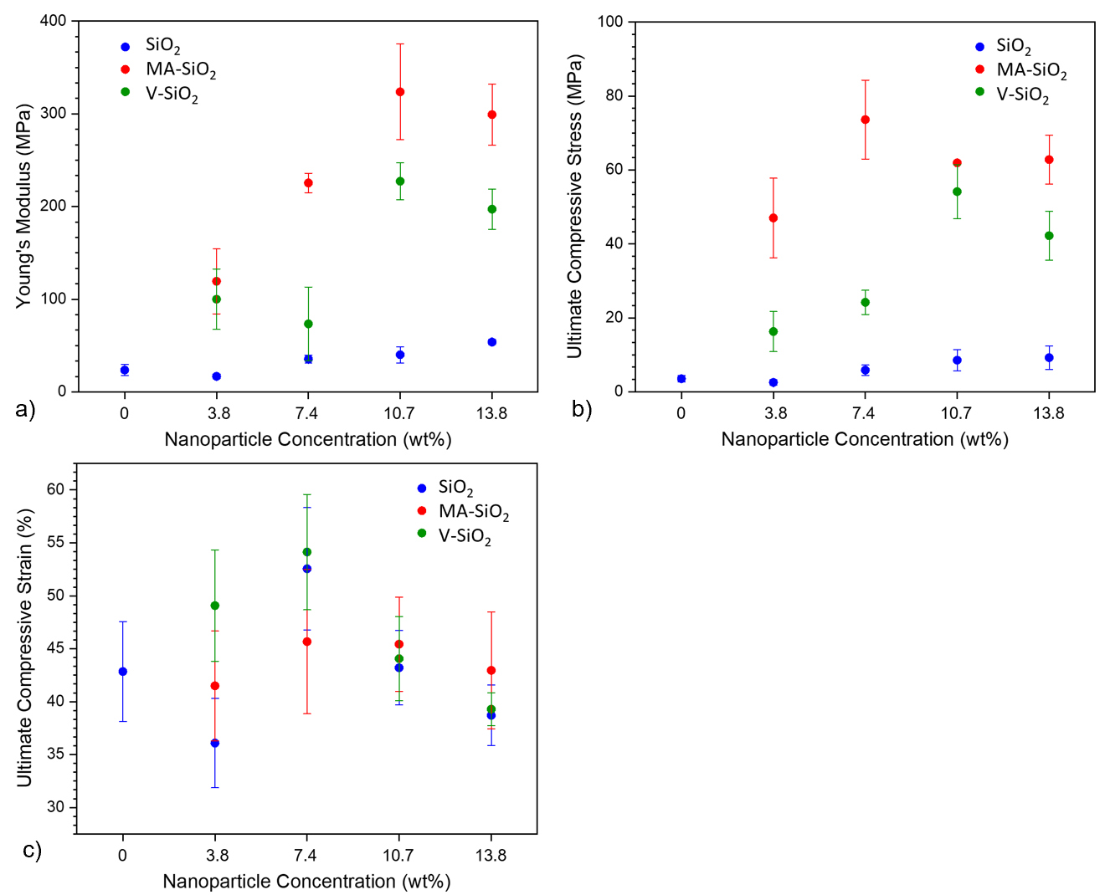
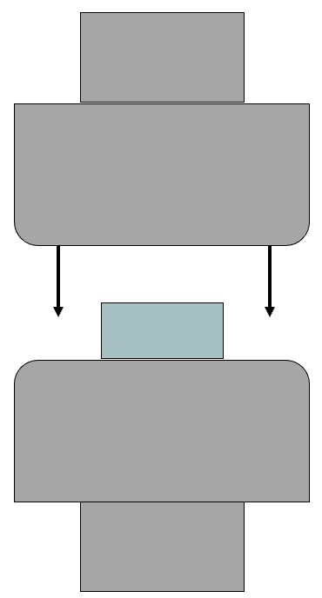
Compressive Testing
7
Compressive testing
MA-SiO₂
Functionalized NP’s allow for a more robust material, contributing to a greater range of properties that these composites can offer.
V-SiO₂
*Hocken, et al. Industrial & Engineering Chemistry Research. 2019, 58 (32).
Notes:
by scavenging radicals, limiting diffusion, or simply by diluting the concentration of monomer in the system

Slide 9
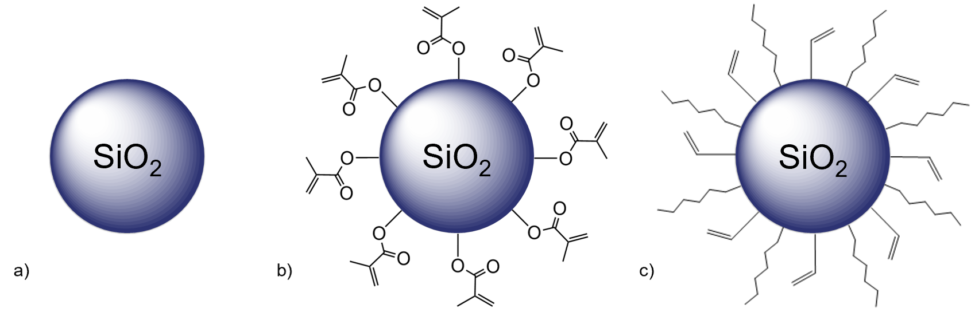
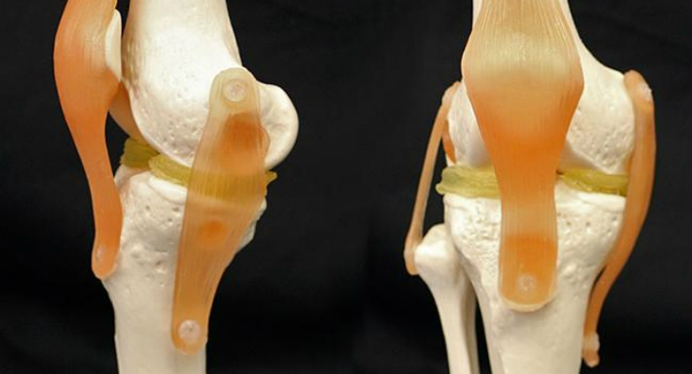
Conclusions & Future Work
8
Finalize manuscript and submit for publication
Moving further, we could investigate the effects of :
  Other nanoscale additives
    Other surface compositions
    Other sizes
  Cross-linker molecular weight
  Photocatalysts

Slide 10






Acknowledgements
9
PI: Dr. Matthew D. Green
ASU/NASA Space Grant Program
Fellow lab members in Green Research Group
Dr. Frederick L. Beyer at the Army Research Lab

